Slide 1
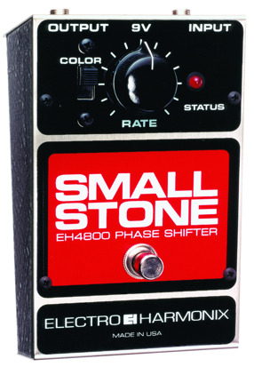
Phasing

Slide 2

Background
Phaser (or phase shifter) creates 1 or more notches in frequency domain that eliminate sounds at notch frequencies
Sometimes called phase shifter
Filter signal to shift phases of different frequencies
Mix filter output with original signal
Some frequencies add constructively, some destructively
Design filters to independently control
Location of each notch
Number of notches
Width of notches
Sound example:
plucked chord sequence
dry, then with phaser

Slide 3
Phaser, Wah-Wah, Flanger
Wah-wah
Based on filters
Varies centre frequency of a bandpass filter
Phaser
Based on filters
Set of allpass filters process the input signal
Arbitrarily spaced notches
Alternatively, implemented with notch filters
Flanger
Relies on delay line
Equally spaced notches
Sound similar to phasing
Can be considered simple type of phasing

Slide 4

How phasing works
Notches implemented using allpass filters
Allpass filter passes all frequencies equally
No amplification or attenuation:
Add filtered output to original
Amount of filtered output controlled by depth or mix control
Where do the notches come from?
x[n]
Allpass
Filter
y[n]
Depth
+
It’s all about the phase

Slide 5
Phase response
Consider “black box” LTI system
Don’t know what’s inside, but linear time-invariant
Observe important characteristics
Magnitude response
Relative amplitude of input and output at each frequency
For allpass filter, these amplitudes are equal
Magnitude response is 1 for all frequencies.
Phase response (or phase lag)
Relative alignment of two signals in time
Allpass filters shift the phase of an input signal

Slide 6
Phase response
Time and phase are inherently related
Phase shift = altering relationship between input and output phases
For a sine wave, phase shift is equivalent to delay
sine wave
with 90⁰ phase lag
180⁰ phase lag
270⁰ phase lag
when original sine wave and 180⁰ phase lag are added together, result is complete cancellation
360⁰ phase lag (one cycle)

Slide 7
Phase response
Practical filters have phase response that changes with frequency
Linear phase (special case)
Phase lag is a linear function of frequency
Could be pure delay
Doubling frequency will double the phase response
No phase distortion (different frequencies arriving at different times)
Symmetric FIR filters are linear phase
Corollary: pure delay is a type of allpass filter

Slide 8
Notches
To create notches, mix allpass filter output with input
At some frequencies, phase lag will be 180º
equivalent to taking negative of input.
frequencies (notches) with 180º phase lag cancel frequency components in input
Frequencies near notch also attenuated
Filter with nonlinear phase response delays signal
not all frequencies delayed by same amount
Linear phase case - pure delay
phase response hits values of -180º minus multiples of 360º (-180, -540...) at equally spaced frequencies
when mix delayed copy of signal with original, notches at equally spaced frequencies
exactly how flanger operates
flanger is type of phase shifter

Slide 9
Allpass filters
Use allpass filters that do not have linear phase characteristic
distort phase response to produce notch at any frequency
# notches determined by filter complexity
chain additional filters to create more notches
series combination of allpass filters is allpass filter
phase response for chain of filters is sum of each filter's phase response
MXR Phase 90 pedal contains 4 stages to create its sound
each stage doesn't necessarily produce a notch
phase response of first order allpass approaches 180º at very high frequencies
multiple stages needed to create notch
unlike flanger, can control width of notches if we want to
parameter often determined in design stage of product
can't be adjusted by user

Slide 10
First order allpass filter
g
flow diagram for first order digital allpass filter
x[n]
y[n]
+
z⁻¹
+
-g
Feedforward and feedback loop gains are negatives of each other

Slide 11





Allpass filtering
Consider a 2nd-order IIR filter
We want
This requires
Which in turn gives:
Notice: and
0°/360° phase shift at DC and Nyquist

Slide 12

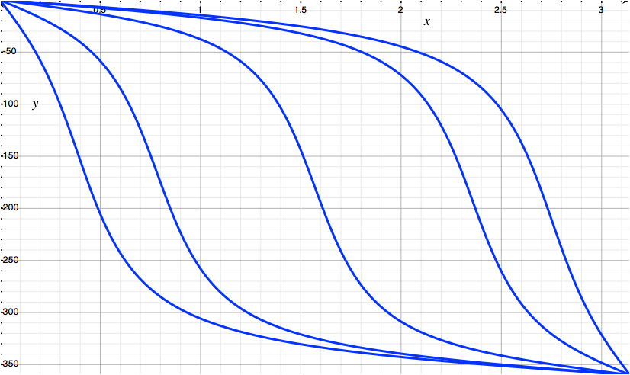
Allpass filtering
Consider the phase
Here showing transition
frequencies:
π/8, π/4, π/2, 3π/4, 7π/8
Phase (-360° to 0°)
Frequency (0 to π)
Frequencies with ~= 180°
phase shift will add destructively
Frequencies with ~= 0°/360°
phase shift will add constructively

Slide 13
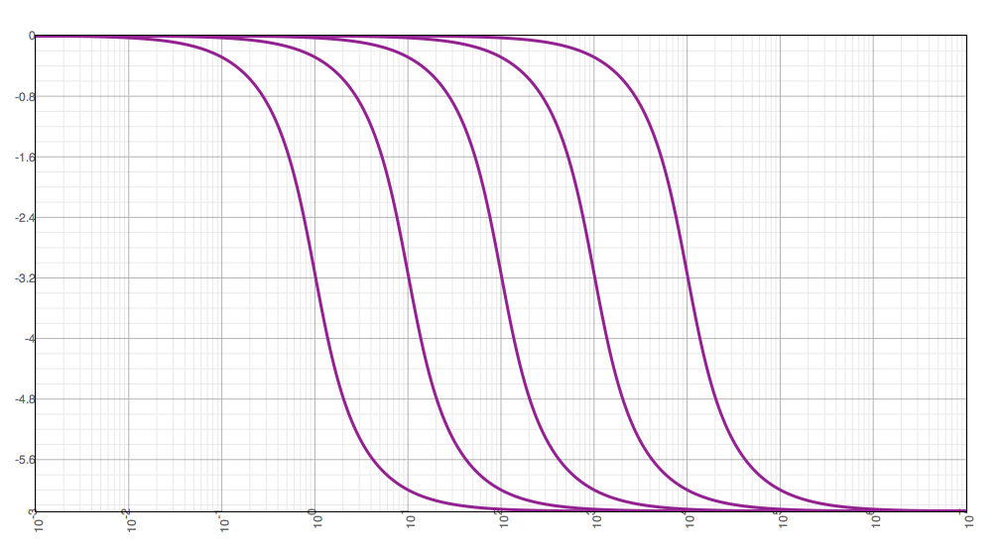
Allpass filtering
IIR allpass filters have nonlinear phase response
Continuous-time and discrete-time IIR filters have different phase response
Discrete-time warping effects
Implications for digital simulation of analogue phasers
Discrete Time (w = 0 to π)
Continuous Time (log(f) scale)

Slide 14
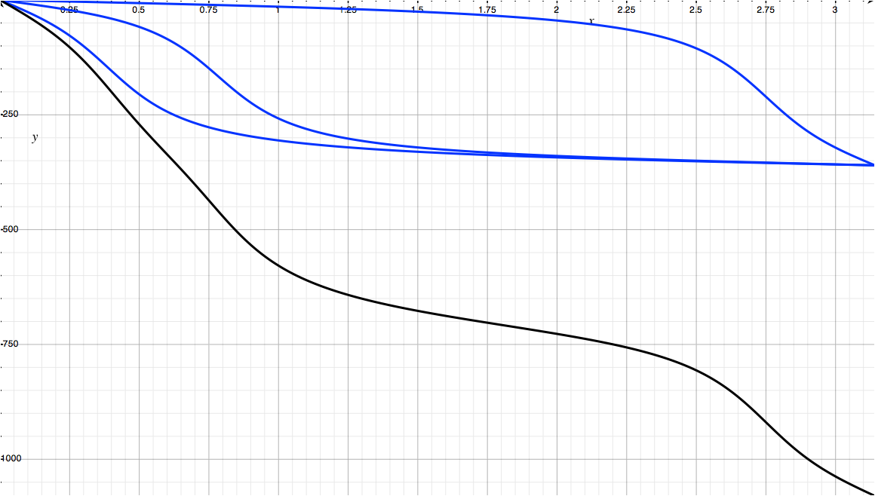
Allpass and notches
Can cascade multiple allpass filters to create more notches
Phase response is sum of individual filters
MXR Phase 90 and Small Stone Phaser include 4 allpass stages
Unlike flanger, phaser can control width of notches
Not commonly user-controllable
Dashed lines show
location of notches
(180° + k*360°)

Slide 15
Allpass filter phase and phaser notch locations. Center frequency 1kHz, sampling frequency 44.1kHz. a, b, c and d represent 1, 2, 3 and 4 second order sections
(a)
(b)
(c)
(d)

Slide 16
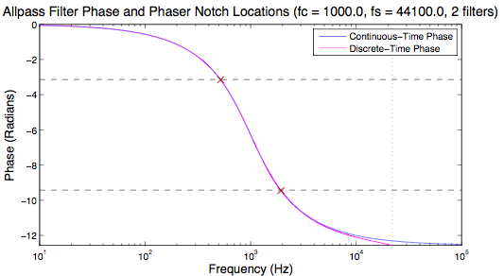
Notch spacing
4 1st-order sections = 2 second-order sections
720° of total phase shift
Where are the notches?
-180° and -540°

Slide 17
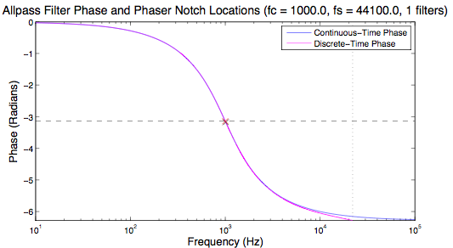
Notch spacing

Slide 18
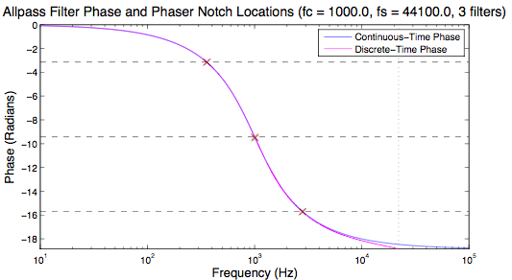
Notch spacing
Notice: not evenly spaced

Slide 19
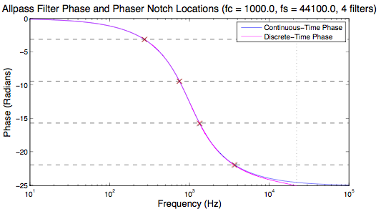
Notch spacing
Adding more sections moves all the notches

Slide 20
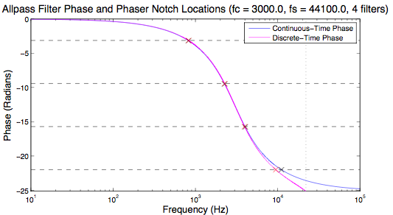
Notch spacing
At 3kHz, start to see an effect from the discrete-time warping
Highest notch off by -2.5 semitones

Slide 21
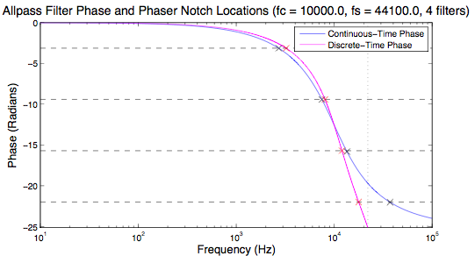
Notch spacing
Warp even more pronounced at 10kHz
Highest notch off by -12.8 semitones!

Slide 22
Sweeping notches
Chorus and flanger
LFO controls delay time
Phaser
Notch frequencies change exponentially
e.g. double notch frequency for each unit time going up, halve notch frequency at each step to return to low point
Most commercial products
limited or no control over how notches sweep
Except overall rate at which they sweep
Sound example: exponential and linear sweep
2 segments of phase shift applied to distorted guitar
notches sweep exponentially along frequency axis
notch sweep is linear
Listen to notches at beginning (low point)
In 1, notches move more slowly at first compared to 2^{d} clip

Slide 23
Common parameters
Depth (mix level)
Amount of filter output added to sound
Name comes from its relation to depth of notches
When depth = 1, notches reach to 0
In some multi-effects processors, depth control may be only in mixer section
Sweep width (sometimes “sweep depth”)
Frequency range notches traverse
Sometimes able to select actual frequency values
Or set deviation from a given base frequency
Compare all this to similar controls on flanger
Distorted guitar sound, processed by phaser with 1 octave sweep depth, then 2 octave sweep depth. rate is same in both cases

Slide 24
Common parameters
Speed or rate:
How quickly notches sweep over frequency range
Oscillations per second
How fast notches move in frequency domain is controlled by
Speed control
Sweep width
Sweep pattern

Slide 25
Feedback / regeneration
Feedback produces more intense sound
Works by adding part of output back to input
Some units allow negative feedback gains
Subtract output from input
For multistage allpass filters:
Can use feedback on individual stages or overall
g_{FB}
x[n]
Allpass
Filter
y[n]
+
Depth
+
Phaser with feedback. Feedback gain can be positive or negative, but must have a magnitude strictly less than 1
strummed guitar using phaser with mild feedback, followed by higher feedback setting

Slide 26
Alternate implementations (1)
Standard implementation: 2nd order allpass filters
Time-varying centre frequencies
Multiple allpass filters in cascade
Time-varying phase shifts
Feedforward and feedback configurations
x[n]
y[n]
Allpass
Allpass
filter
...
Allpass
filter
g
+
filter
+
g_{FB}

Slide 27
Alternate implementations (2)
Cascade of 2nd order IIR notch filters
Combine notch outputs and direct sound
Notch frequencies slowly varied (LFO)
Notch filters also produce phase shift
Combines with input phase to create cancellations
x[n]
Notch
filter
+
y[n]
Notch
filter
Notch
filter
...
g

Slide 28
Stereo phasing
Like stereo flanger and chorus
2 filters with notches at different frequencies
Selectively mix output of each filter to create new sounds (additional notches)
Spatial phaser
Feed-across gains set to 0
Each output fed to different speaker
Notches exist only in air (acoustic cancellation) and heard by moving about room
y₁[n]
Allpass
x [n]
y₂[n]
Allpass

Slide 29
Phaser C++ code
int numSamples; // Indicates how many audio samples to process
float *channelData; // Array of audio samples, length numSamples
float ph; // Current phase of the LFO (0-1)
float lastFilterOutput; // Output of the filter last sample, for implementing feedback
OnePoleAllpassFilter **allpassFilters; // Objects handling a first order allpass filter
float inverseSampleRate; // Defined as 1.0/(sample rate)
int sc; // Sample count, used to decide when to update the coefficients
float depth_; // Depth of the phaser effect (0-1)
float feedback_; // Amount of feedback (>= 0, < 1)
float lfoFrequency_; // Frequency of the LFO
float baseFrequency_; // Lowest point in the sweep of the allpass center frequency
float sweepWidth_; // Width of the LFO (in Hz)
int waveform_; // Identifier of what type of waveform to use (sine, triangle, ...)
int filtersPerChannel_; // How many allpass filters are used
int filterUpdateInterval_; // How often to update the allpass coefficients
for (int sample = 0; sample < numSamples; ++sample)
{
float out = channelData[sample];
…[SEE NEXT SLIDE]
}

Slide 30
Phaser C++ code
//If feedback on, feedback last sample to input of allpass filter chain
If (feedback_) out += feedback_ * lastFilterOutput;
for(int j = 0; j < filtersPerChannel_; ++j)
{
// Update current allpass filter coefficients depending on parameter
// settings & LFO phase. Only update coefficients at fraction of sample
// rate; since LFO is slow, difference won't generally be audible.
if(sc % filterUpdateInterval_ == 0) allpassFilters[j]->makeAllpass(
inverseSampleRate, baseFrequency_ + sweepWidth_* lfo(ph, waveform_));
out = allpassFilters[j]->processSingleSampleRaw(out);
}
lastFilterOutput = out;
// Add allpass signal to output, maintaining constant level
// depth = 0 --> input only ; depth = 1 --> evenly balanced input and output
channelData[sample] = (1-0.5*depth_)*channelData[sample] + 0.5*depth_*out;
// Update LFO phase, keeping it in range 0-1
ph += lfoFrequency_*inverseSampleRate;
if(ph >= 1.0) ph -= 1.0;
sc++;

Slide 31
Allpass filter code
The expression allpassFilters[j]->processSingleSampleRaw(out) runs the following code for each allpass filter object:
float OnePoleAllpassFilter::processSingleSampleRaw(float sampleToProcess)
{
// Process one sample, storing the last input and output
y1 = (b0 * sampleToProcess) + (b1 * x1) + (a1 * y1);
x1 = sampleToProcess;
return y1;
}
Here, x1 and y1 keep track of the last input and output x[n-1] and y[n-1] respectively. b0, b1 and a1 are coefficients of the filter, as calculated by the makeAllpass() function in the previous code block.

